Slide 1
04-800 AB Machine Learning for Earth Observation: LAB2
Session: Introduction to Google Earth Engine (GEE)
On 8th February 2024
Instructor: Moise Busogi
TAs:
Gustave Munezero Bwirayesu &
Deo Uwimpuhwe

Slide 2
Agenda
Introduction to GEE
Characteristics of remotely sensed data
Spectral indices
Data cleaning

Slide 3
Intro to Google Earth Engine
Cloud-based geospatial analysis platform
Brings together more than 40 years of historical and current global satellite imagery
Provides the tools and computational power necessary to analyze and mine vast data warehouse
Enables visualization and examination of satellite imagery of Earth.
Utilized for tasks such as remote sensing research, managing natural resources, etc.

Slide 4
Characteristics of remotely sensed data
Spatial resolution
Spectral resolution
Important for capturing spatial information on the ground.
Spatial resolution determines the pixel information.
High or low resolution (Choice follows application and resources).
Practically, sensor's instantaneous field of view (IFOV) on the ground follows spatial resolution.
It refers to the number of spectral bands in which the sensor takes measurements.
A sensor that measures radiance in multiple bands is called a multi-spectral sensor,
A sensor that measures radiance in many bands (possibly hundreds) is called a hyper-spectral sensor.
Ground features may differ or resembles in certain wavelengths (reflectance).

Slide 5
Characteristics of remotely sensed data (cont’d)
Temporal resolution
Radiometric resolution
It refers to the amount of time the sensor takes to return at a location through it's IFOV.
Also known as the revisit time, or temporal cadence of the image data.
Think of this as the frequency of pixels in a time series at a given location.
Sensors (or satellites) constellation is mostly used to reduce revisit time.
Determined from:
The minimum radiance to which the detector is sensitive (L_{min}),
The maximum radiance at which the sensor saturates (L_{max}), and
The number of bits used to store the DNs (Q)
Radiometric resolution = (L_{max} - L_{min})/2^{Q}.
Provides distinction within the same spectral band.
Necessary when interested in phenomena that are distinguished by very subtle changes in radiance

Slide 6
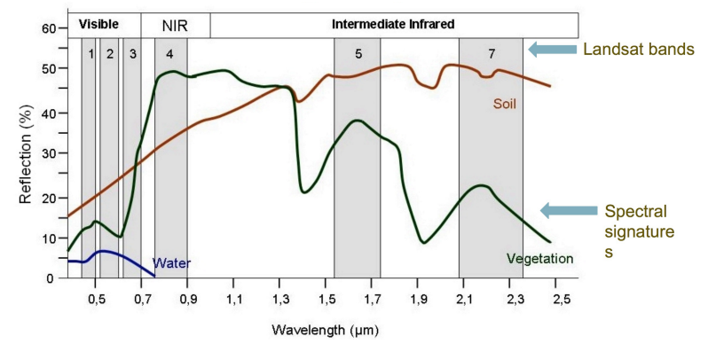
Spectral Indices
Reflectance spectra of different land covers are different.
Indices exploit these differences to accentuate particular land cover types

Slide 7
Examples Spectral Indices
The Normalized Difference Vegetation Index (NDVI)
Determines the amount and health of vegetation in an area
NDVI = (NIR - RED ) / (NIR + RED )
The Enhanced Vegetation Index (EVI) Huete et al. 2002
Minimizes saturation and background effects in NDVI
2.5 * ((NIR - RED) / (NIR + 6 * RED - 7.5 * BLUE + 1))

Slide 8
Examples Spectral Indices
The Normalized Difference Water Index (NDWI) Gao (1996)
used to monitor changes related to water content in water bodies
NDWI = (NIR - SWIR) / (NIR + SWIR)
The Normalized Difference Bare Index (NDBI) Zha et al. (2003)
Aid in the differentiation of urban areas.
Note that NDBI is the negative of NDWI
NDBI = (SWIR - NIR) / (SWIR + NIR)

Slide 9
GEE Lab
Link to the lab:
Colab: https://colab.research.google.com/drive/1uzC3DhXq9OUi0rlT-7PvSYoCB5CQHLhU?usp=sharing

